Slide 1
Day 3 – Java Core Platform
Course Code: TAPL1LF011 Course Name: Core Java
Trainer Name: Thiruppathi
Java Trainer

Slide 2
Learning Outcome – Session 2
Exception Handling
Introduction
Error Handling with Exceptions - Try
Handling Exceptions by Type - catch
Exceptions and Methods
Throwing Exceptions and Custom Exceptions

Slide 3
Exception Handling
Abnormal situation, that terminates the normal flow of program.
Exception can be of 2 types
1. System Defined
a) Checked Exception
b) Unchecked Exception
2. User Defined
Extends from Throwable interface.

Slide 4
Checked Exception
This exception will came at compile time.
The Predefined exception are
1) FileNotFoundException
2) ClassNotFoundException
3) IOException
4) SQLException

Slide 5
Unchecked Exception
This Exception is checked at during Run time
This Exception are:
1) ArithmeticException
2) ArrayIndexOutOfBoundsException
3) NumberFormatException
4) NullPointerException

Slide 6
Exception Handling
Keywords used
1) try
2) catch
3) finally
4) throw
5) throws

Slide 7
Try Block
The first step in constructing an exception handler is to enclose the code that might throw an exception.
Syntax
try{
….
}
catch or finally

Slide 8
Catch block
Each catch block is an exception handler that handles the type of exception indicated by its argument.
The argument type, ExceptionType, declares the type of exception that the handler can handle.
It must be the name of a class that inherits from the Throwable class.
The handler can refer to the exception with name.

Slide 9
Syntax - catch
try
{
….
}
catch(exception_name1){
……
}
catch(exception_namen){ …… }

Slide 10
finally block
The finally block always executes when the try block exits.
This ensures that the finally block is executed even if an unexpected exception occurs.
finally is useful for more than just exception handling.
It allows the programmer to avoid having cleanup code accidentally bypassed by a return,

Slide 11
Exception handler in method
Specify the method that thrown an exception.
By using the keyword “throws” we can throw the exception.
For Example
public void writeFile() throws IOException {
…
}

Slide 12
Throwable and Custom Exception
All methods use the throw statement to throw an exception.
The throw statement requires a single argument: a throwable object.
Throwable objects are instances of any subclass of the Throwable class. Here's an example of a throw statement.
throw someThrowableObject;
For Example: inside a method we can use
throw new EmptyStackException();

Slide 13
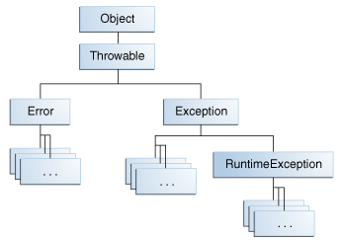
Throwable class

Slide 14
Custom Exception
User can define the exception at their own way based on our application.
Syntax
class ExceptionClassName extends Exception
{
ExceptionClassName(String s)
{
super();
}
}

Slide 15
Thank You
Any Queries?

